Slide 1
Network Analytics Team Members
Renato Barroco & Joaquin Gianantonio
Notes:
This is the slide where you actually SAY your 1-2 sentence elevator pitch. Engage your audience!!

Slide 2
Presentation Outline
Definition of the Problem
Our Proposed MLE Solution
Information about the Data & ML Model
Demo
MLE Stack
Conclusions (and lessons learned)
Future Work

Slide 3
Definition of the Problem
Network infrastructures are at risk from cyber-attacks and intrusions.
This is an ever-increasing concern as we continue to expand the applications of modern-day networking: i.e., Internet Of Things, smart homes, etc.
Cyber-attacks and intrusions can compromise their availability, confidentiality, and integrity.
But these threats are difficult to detect unaided because they display network traffic patterns almost indistinguishable from normal traffic.
[estimation of of losses due to network attacks: xxxx, Source xxx]
Notes:
Specify what Problem is being solved, and ensure that everyone is in agreement as to Why that’s a problem.

Slide 4
Our Proposed Solution
We propose developing a ML-based Network Intrusion Detection alarm system that can provide rapid identification of potential intrusions.
This alarm system will:
alert network administrators to take corrective action and minimize its impact.
let network engineers develop responses based on information from the app.
The alarm will help reduce interruption of service and avoid, or reduce, interrupting critical tasks and its associated cost for the user and provider.
The intrusion detection alarm will monitor network flow (at port level) and robustly identify threats with high accuracy and provide multi-class classification results.
Notes:
Specify what Success looks like, and for what Audience.

Slide 5
Information about the Data
Our proposed dataset (University of Nevada – Reno, Intrusion Detection Dataset, UNR-IDD) is based on a custom application that collects and logs the available statistics captured periodically (every 5 sec – tumbling windows) from OpenFlow switches. Delta port statistics are also computed.
The main difference between UNR-IDD and other existing datasets is that UNR-IDD consists primarily of network port statistics.
UNR-IDD also address the limitation of the presence of tail classes, that there are enough samples for ML classifiers, and ensures that there are no missing network metrics.
We expect that the use of a multi-label classification for network analysis will provide a robust identification of network flow, giving (a Security Team) a better understanding of the type of port flow.
The model Network Intrusion Detection should be deployed to be hit from an API or some sort of streaming process/batch load as events are generated. (Dashboard)
Source: Tapadhir Das - UNR-IDD Dataset

Slide 6
Information about the data (Multi-class classification)

Slide 7
Information about the data (network topology)

Slide 8
Information about the data (network topology)
Received Packets
Number of packets received by the port
Received Bytes
Number of bytes received by the port
Port statistics collected for every port on every switch
Sent Packets
Number of packets sent by the port
Sent Bytes
Number of bytes sent
Port alive Duration
The time port has been alive in seconds

Slide 9
Information about the Model
We tested linear regression models.
According to the NID literature, random forest models are the more widely used.
We used a Tree-based Pipeline Optimization Tool (TPOT), a Python Automated Machine Learning tool, for model selection and parameter optimization.
We selected and used an XGBoostClassifier for the multi-label classification project.
XGBC is s a decision tree ensembled learning algorithm similar to random forest.

Slide 10









MLE Stack / EDA - Data Engineering - ML
Throughout the project we utilized the power of Github for version control and collaboration among team members.
EDA
Experimentation
Data Engineering
Feature selection
Pipeline
Data preprocessing
Model selection – lgr
Metrics
Took advantage of TPOT capabilities to select and fine tune a ML model.
Extreme Gradient Boost
parallel tree boosting
ML classification lib

Slide 11




MLE Stack / Deployment
Containerization for back-end deployment
Lightweight WSGI web application framework
Enables the creation of scalable and quick back-end RESTful APIs
Front-end library that creates interactive user interfaces

Slide 12

Demo

Slide 13
Demo Challenges
Full workflow implementation;
Deployment in a dashboard? What tool to use?
How to simulate the use of real data to validate/test the solution?
We used unseen, test data for the Demo.
How often a model like that would need to be retrained to reflect the dataset/data drift?

Slide 14
Conclusions
We learned to do end-to-end ML the easy way, the hard way is to be able to deploy and monitor the model daily; mapping data drift and applying re-training the model using devOps solutions;
Important aspect of any MLE solution is the data engineering part of the project;
We learned to do end-to-end ML the easy way, the hard way
Let us tell you about it!
Here’s a tip or two for anyone who tries to walk down a similar path!
And the biggest lesson we’re taking with us into the future is …
This is where you can tell funny stories about the stupid things you did!
Notes:
This is where you can tell funny stories about the stupid things you did!
This is also the slide where you might convey the difference between what you set out out to do, and what you actually did.

Slide 15
Future Work
Real time streaming using KAFKA, Autoloader & Databricks delta lake for real-time threat detection,
Dashboarding using plotly, databricks environment,
Data drift analysis with a robust devOps, CICD deployment.

Slide 16
[https://github.com/JoaquinGianan/network-analytics] [link to demo?] Thank You! Questions?

Slide 17
Appendices Team Members
Renato Barroco & Joaquin Gianantonio

Slide 18
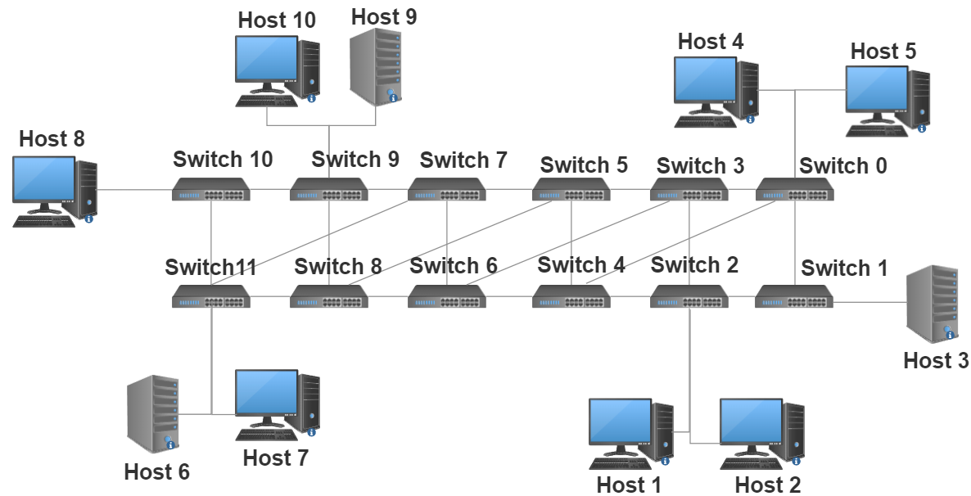
Information about the data (network topology)
Flow Simulation: IPerf is used to create TCP and UDP data streams simulating network flows in virtual and real networks using dummy payloads.
Data Collection: we create a custom application to collect and log the available statistics that are captured periodically (once in every 5 seconds) from OpenFlow (OF) switches. The statistics are collected through by means of OFPPortStatsRequest and OFPPortStatsReply messages between controller and switches.
Source: Tapadhir Das - UNR-IDD Dataset

Slide 19
Information about the Data
For this Capstone project we are using data fron the University of Nevada.
Specifically, their Reno Intrusion Detection Dataset (UNR-IDD).
The main difference between UNR-IDD and other existing datasets is that UNR-IDD consists primarily of network port statistics.
These refer to the observed port metrics recorded in switch/router ports within a networking environment.
The dataset also includes delta port statistics which indicates the change in magnitude of observed port statistics within a time interval.
Compared to datasets that primarily use flow level statistics, these port statistics can provide a fine-grained analysis of network flows from the port level as decisions are made at the port level versus the flow level.
This can lead to rapid identification of potential intrusions.
UNR-IDD also address the limitation of the presence of tail classes.
The dataset ensures that there are enough samples for ML classifiers to achieve high F-Measure scores, uniquely.
Our proposed dataset also ensures that there are no missing network metrics and that all data samples are filled.

Slide 20
Other Datasets
As mentioned above, the three prominent NIDS datasets
are NSL-KDD [5], CIC-IDS-2018 [6], and UNSW-NB15 [3].
These datasets also have several limitations. For instance,
the UNSW-NB15 suffers from inconsistent performance for
machine learning classifiers. It requires more rigorous and
expanded machine learning mechanisms which increases training
and inference times. The NSL-KDD and CIC-IDS-2018
datasets suffer from missing data samples within their datasets.
Many of these datasets also suffer from the issue of containing
inadequately modeled tail classes which leads to inconsistent
performance.
For more effective intrusion detection, we need to ensure
that a dataset contains a wide variety of intrusion categories.
We also need to make sure that it is complete as missing data
can negatively impact the performance of prediction models.
The primary usage of port level statistics, in conjunction with
some flow statistics, for NIDS is another attractive research
direction that can be employed to check their efficacy at
detecting network intrusions. Lastly, it is critical to ensure
that tail classes have adequate representation so that prediction
models can accurately capture their unique behavior and attain
high performance.

Slide 21
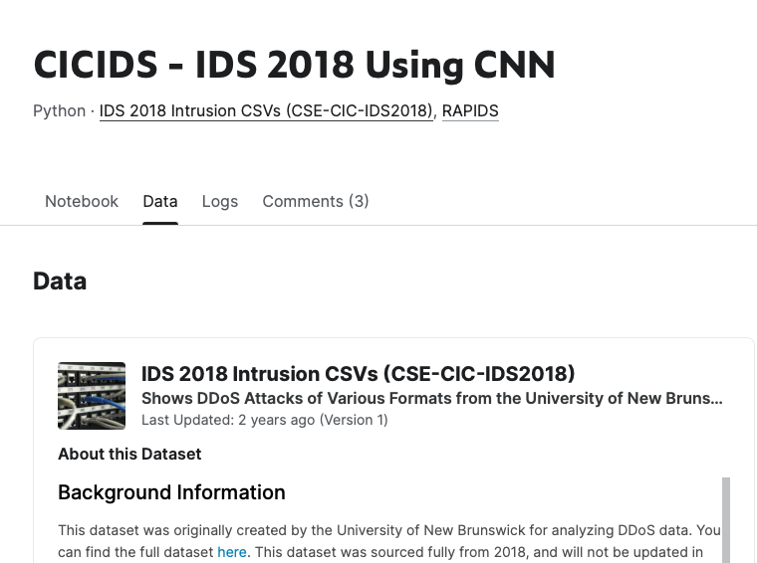

Other Datasets

Slide 22
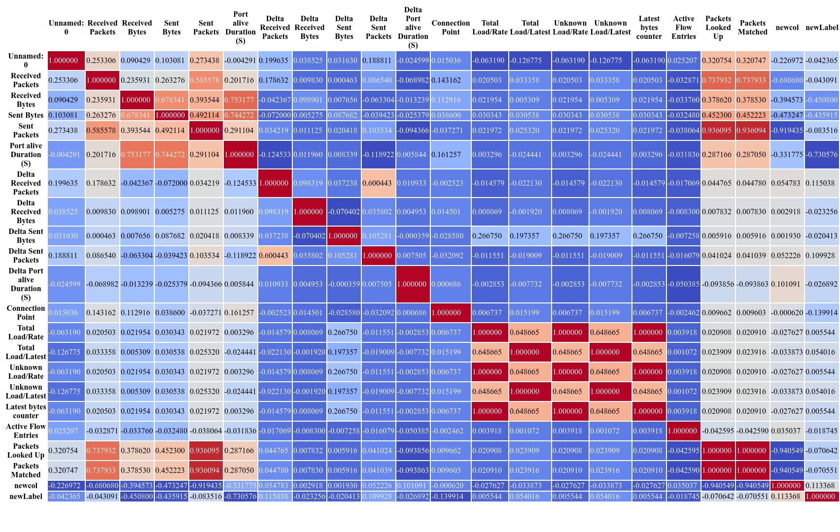
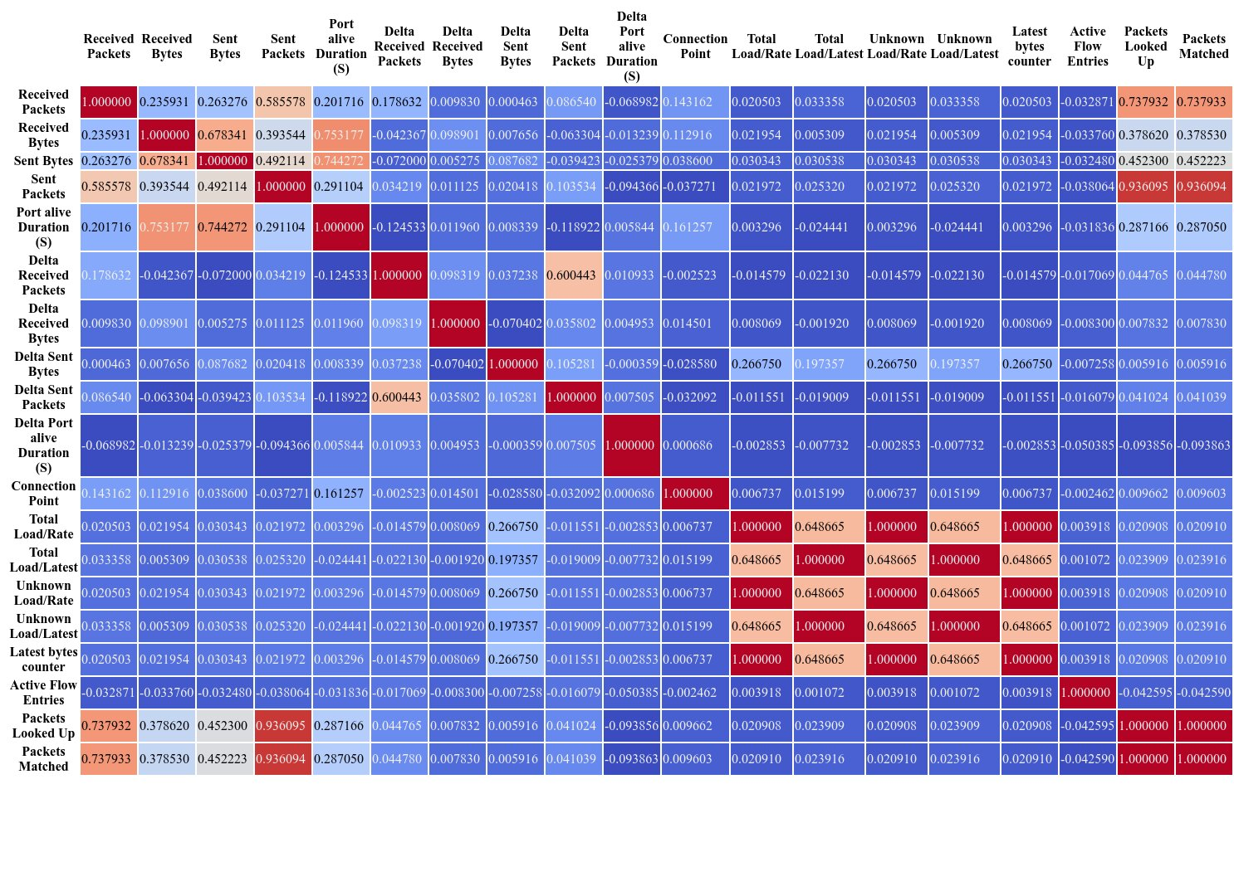
EDA
Correlation analysis performed on dataset

Slide 23
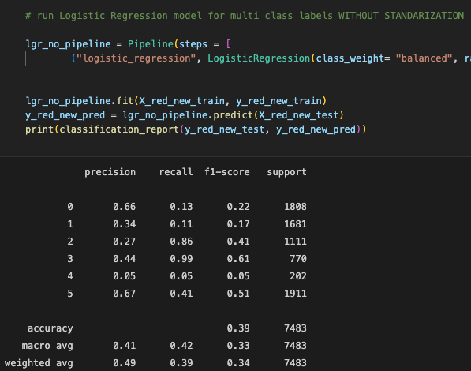
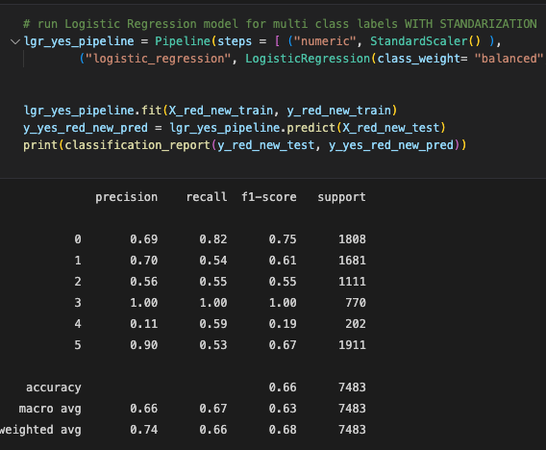
Appendices / LGR model runs

Slide 24
Model description XGBClassifier
A Gradient Boosting Decision Tree is a decision tree ensemble learning algorithm similar to random forest. Ensemble learning algorithms combine multiple machine learning algorithms to obtain a better model.
The term “gradient boosting” comes from the idea of “boosting” or improving a single weak model by combining it with a number of other weak models in order to generate a collectively strong model. Gradient boosting is an extension of boosting where the process of additively generating weak models is formalized as a gradient descent algorithm over an objective function. Gradient boosting sets targeted outcomes for the next model in an effort to minimize errors. Targeted outcomes for each case are based on the gradient of the error (hence the name gradient boosting) with respect to the prediction.
GBDTs iteratively train an ensemble of shallow decision trees, with each iteration using the error residuals of the previous model to fit the next model. The final prediction is a weighted sum of all of the tree predictions. Random forest “bagging” minimizes the variance and overfitting, while GBDT “boosting” minimizes the bias and underfitting.
XGBoost is a scalable and highly accurate implementation of gradient boosting that pushes the limits of computing power for boosted tree algorithms, being built largely for energizing machine learning model performance and computational speed. With XGBoost, trees are built in parallel, instead of sequentially like GBDT. It follows a level-wise strategy, scanning across gradient values and using these partial sums to evaluate the quality of splits at every possible split in the training set.

Slide 25
Information about the Model – TPOT run used
import numpy as np
import pandas as pd
from sklearn.model_selection import train_test_split
from xgboost import XGBClassifier
# NOTE: Make sure that the outcome column is labeled 'target' in the data file
tpot_data = pd.read_csv('PATH/TO/DATA/FILE', sep='COLUMN_SEPARATOR', dtype=np.float64)
features = tpot_data.drop('target', axis=1)
training_features, testing_features, training_target, testing_target = \
train_test_split(features, tpot_data['target'], random_state=42)
# Average CV score on the training set was: 0.9521518326659425
exported_pipeline = XGBClassifier(learning_rate=1.0, max_depth=5, min_child_weight=8, n_estimators=100, n_jobs=1, subsample=0.8500000000000001, verbosity=0)
# Fix random state in exported estimator
if hasattr(exported_pipeline, 'random_state'):
setattr(exported_pipeline, 'random_state', 42)
exported_pipeline.fit(training_features, training_target)
results = exported_pipeline.predict(testing_features)

Slide 26
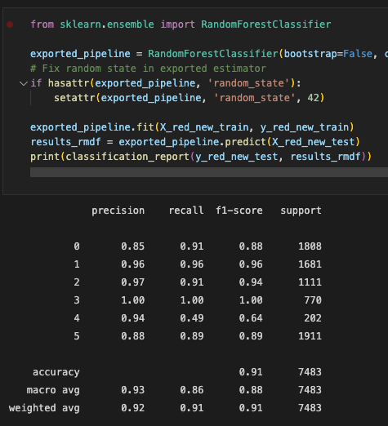
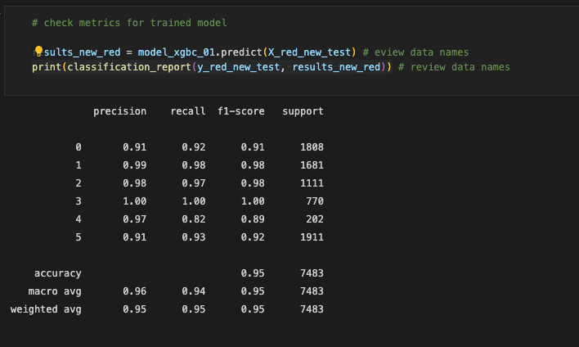
Appendices / TPOT model runs

Slide 27
Appendices

Slide 28
Appendices

Slide 29
Appendices

Slide 30
Appendices

Slide 31
Appendices

Slide 32
To be continued … Team Members
Renato Barroco & Joaquin Gianantonio

Slide 34
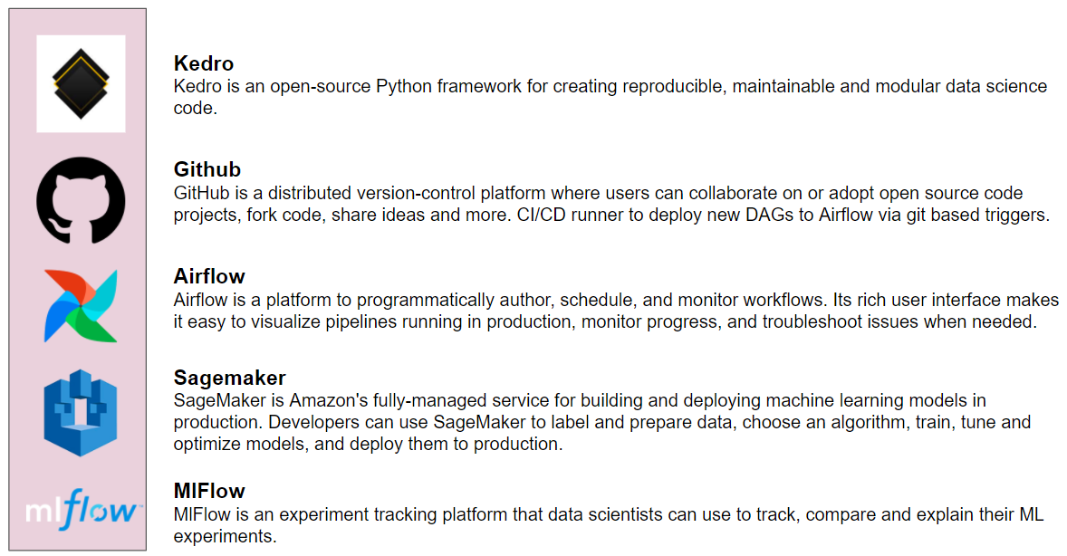
MLE Stack (2 min)
Source: https://write.agrevolution.in/ds-pipeline-the-much-needed-data-science-infrastructure-design-part-1-the-concept-4ceb57944974

Slide 35
Industry insights
Deep Learning for Network Traffic Monitoring and Analysis (NTMA)
https://www.sciencedirect.com/science/article/pii/S0140366421000426#b96
The experiments revealed that DL models provides better accuracy (with 99.20%) than the classical ML models (with 95.22%).
The authors claimed that in highly distributed networks, such as IoT systems, the traditional techniques such as classical ML techniques for NTMA purposes (e.g., attack detection) have less scalability. As a result, they proposed edge-based deep learning to deal with modern communication systems’ distributed and complex nature. The vast amount of data generated by IoT edge devices allow DL models to learn more useful than classical ML models.
https://learn.microsoft.com/en-us/azure//streaiot-hub/iot-hub-live-data-visualization-in-power-bi
https://www.databricks.com/blog/2022/05/05ming-windows-event-logs-into-the-cybersecurity-lakehouse.html
Notes:
Specify what Success looks like, and for what Audience.

Slide 36
Exploration model – DeepInsight with Squeezenet
DeepInsight:
A methodology to transform a non-image data to an image for convolution neural network architecture
https://www.nature.com/articles/s41598-019-47765-6
Examples:
https://github.com/alok-ai-lab/pyDeepInsight/blob/75ac7e62d5c10c35828b76bd547ec9e66960303c/examples/pytorch_squeezenet.ipynb
Notes:
Specify what Success looks like, and for what Audience.

Slide 37
DeepInsight pipeline
If the data dimensionality is extremely large and difficult to handle due to hardware limitations, then the dimensionality reduction technique (DRT) may be considered before applying DeepInsight.
The DRT can be either in the form of feature selection or feature extraction depending upon the nature of the problem.
The application of DRT will provide a small feature set which will help in faster processing, however, can risk classification performance. On the other hand, if noisy or redundant features are removed then it could help to get higher processing speed as well as better accuracy. Since the application of DRT is case dependent, we have described DeepInsight without applying DRT.
Notes:
Specify what Success looks like, and for what Audience.

Slide 38
DeepInsight pipeline
The conversion from Cartesian coordinates to pixel frames is done by averaging some features as the image size has a pixel limitation.
Drawbacks and concerns:
1) If the resolution of image or grid size is very small (compared to the number of features given), then many features overlap with each other, and image representation may not be very accurate. An appropriate resolution should be selected given the hardware capacity and the number of features required to process. Alternatively, dimensionality reduction may be applied a priori.
2) The authors acknowledge the fact that classical ML algorithms that employ experts- and manually-based methods for feature extraction are not appropriate for modern networks due to: (1) handheld devices’ massive deployment, such as smartphones and tablets, considerably increases mobile traffic volume, (2) the massive adoption of the encrypted network protocols, e.g., Transport Layer Security (TLS), reduces the effectiveness of DPI techniques based on ML algorithms, and (3) considering the ever-increasing development of mobile applications and the changing nature of mobile traffic, implementing up-to-date and accurate traffic classifiers through classical ML algorithms is challenging.
Notes:
Specify what Success looks like, and for what Audience.

Slide 39
Models
Aceto et al. [x] studied DL-based models for mobile traffic classification. They reproduced several DL classifiers, e.g., MLP, LSTM, CNN, and SAE, from the traffic classification literature in order to make a comprehensive evaluation for showing the accuracy of these classifiers.
Among DL-based classifiers, the best performance is related to 1D-CNN with 76.37%/85.70% accuracy and the F-measure of 75.56%/78.78% on FB-FBM and Android dataset, respectively.
Notes:
Specify what Success looks like, and for what Audience.

Slide 40
Models (industry)
https://www.nature.com/articles/s41598-019-47765-6
As mentioned, one of the main advantages of CNNs compared to conventional neural networks is the automatic detection of the important features and hierarchical feature extraction. A simple CNN model proposed in [93] for the categorization of encrypted traffic. This paper is one of the first works leveraging CNNs in the context of traffic classification, in which encrypted traffic is transformed into two-dimensional images, and then the images fed into the CNN model to be classified.
The authors reported an accuracy of 1D-CNN 1%, 82%, 98%, and 86%, and 2D-CNN 1%, 80%, 97%, and 84% for four different experiments, respectively. The main advantages of the method presented in this work over the existing traffic classifiers, such as classical ML classifiers, include:
(1) integrating feature extraction/selection/classification phases into an end-to-end framework;
(2) categorization of the encrypted network traffic which is a challenging task for the traditional classifiers
Notes:
Specify what Success looks like, and for what Audience.

Slide 41
Models (industry)
https://www.nature.com/articles/s41598-019-47765-6
In [94], the authors also adopted the CNN model for IP traffic classification. They converted sequences into images that fully represent the patterns of different applications, such as Facebook and Instagram. Then, the CNN model is employed to classify the images to different applications. Rezaei and Liu proposed a one-dimensional CNN-based semi-supervised approach to categorize five Google applications [95]. To reduce the need for large labeled traffic datasets, first, the model is pre-trained on a big unlabeled training test where the time series characteristics of a few samples of packets are considered as the input.
The proposed method’s performance is evaluated with different sampling techniques (i.e., fixed step sampling, random sampling, and incremental sampling) on three different datasets, including the QUIC dataset, Unlabeled Waikato dataset, and Ariel dataset. The proposed pre-trained method achieved higher accuracy than its non-pre-trained counterpart, with 81.50%, 81.27%, and 80.76% on the QUIC dataset for the sampling techniques. As mentioned, the authors use a 1D-CNN as a classifier because they believe the using of new applications and network encryption techniques have considerably raised the complexity of the traffic classification tasks, mainly when one uses classical ML-based methods.
Notes:
Specify what Success looks like, and for what Audience.

Slide 42
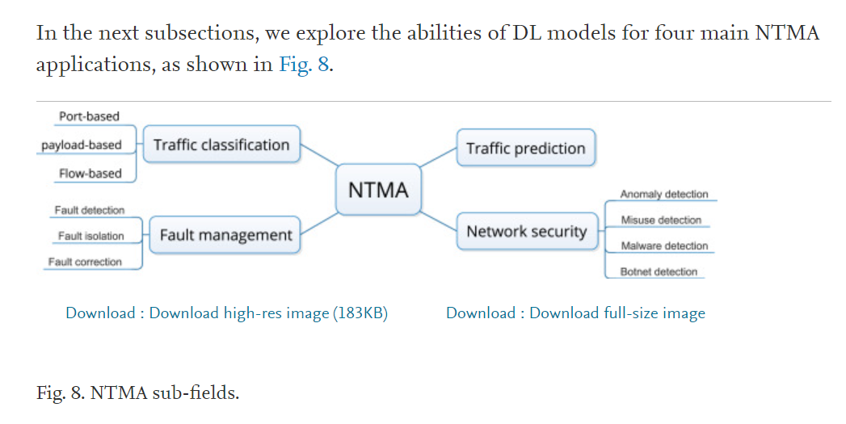
Industry insights
Notes:
Specify what Success looks like, and for what Audience.

Slide 43
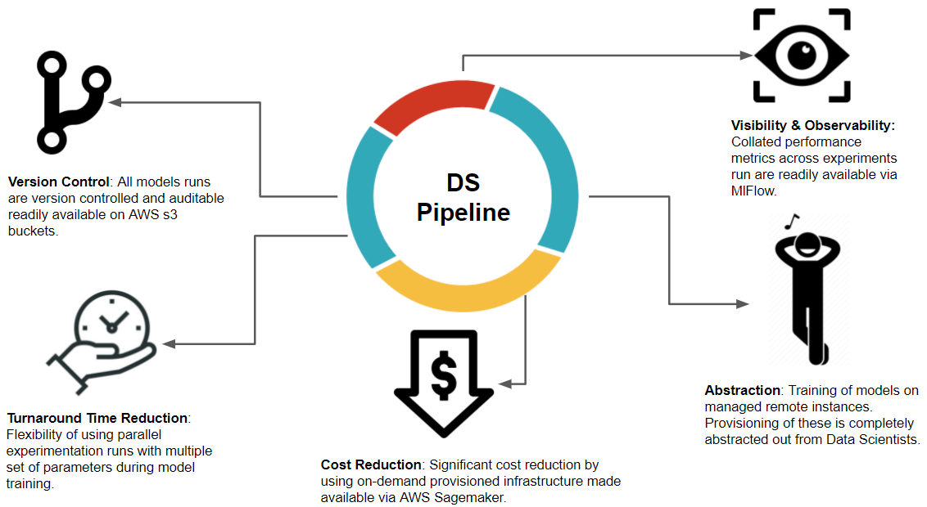
MLE Stack
Use pipelines

Slide 44
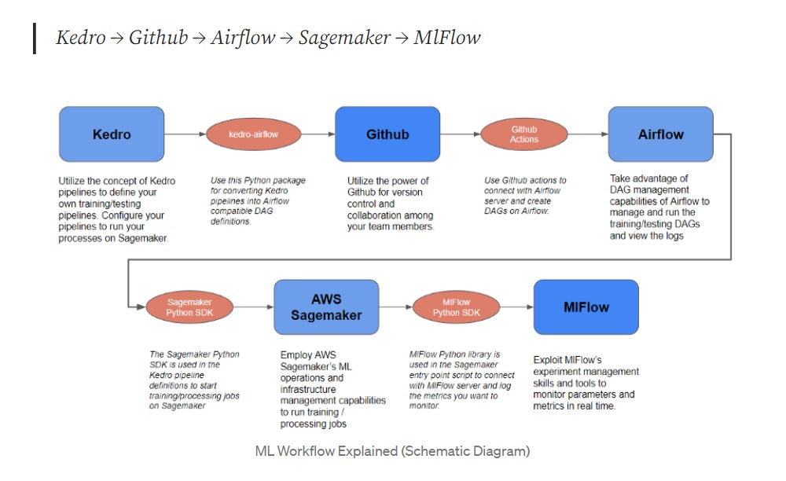
Our Proposed Solution [[LET’S REVIEW/ CHANGE]]
Source: https://write.agrevolution.in/ds-pipeline-the-much-needed-data-science-infrastructure-design-part-1-the-concept-4ceb57944974
Notes:
Specify what Success looks like, and for what Audience.

Slide 45
MLE Stack (initial proposal) [not in our project]use Renato’s pipeline schema
Reusable Code Structure for building ML Models
Experiment Tracking with model Artifacts
Training of Models on Managed Remote instances
Version control of Trained models
Git-based triggers to train and deploy models
Deployment of Trained models on Managed Remote instances
Monitoring and Logging of deployed models
Integration of Deployed endpoints with API Gateway

